Slide 1
Paychex Consumer Portal
Enrolling and Filing Claims Online in your Employer Sponsored Pre-Tax Benefit Plans

Slide 2
Online Enrollment
Eligible participants can enroll online during the 2022 Open Enrollment period, which runs from November 8, 2021, through November 30, 2021*.
Note: You must re-enroll in the plan each year, as your current election will not automatically roll over into 2022.
Notes:
* Open enrollment dates are based on a 1/1/2017 plan start date. If you plan year start is not 1/1, please use the following calculation to determine open enrollment start date: Open enrollment begins on the 2nd Tuesday of the month, 2 months prior to the plan start date and runs for 3 weeks).

Slide 3
Online Enrollment
Online Enrollment in a Flexible Spending Account or a Health Reimbursement Account is a step-by-step process comprised of six steps:
Profile
Dependents (optional)
Plan Rules
Elections
Payment Method
Enrollment Verification

Slide 4
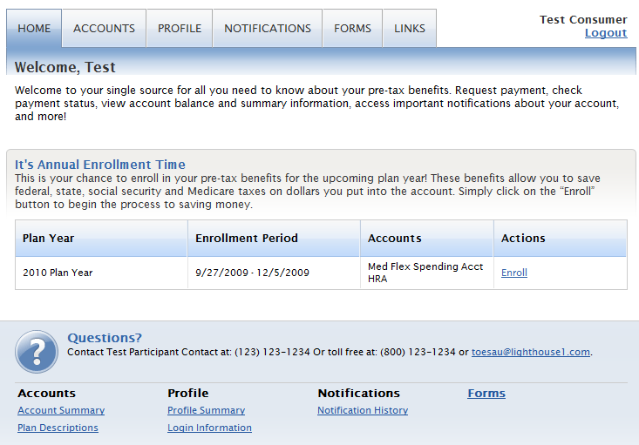
Online Enrollment
To begin enrollment, go to https://paychex.lh1ondemand.com and enter your User ID and password.
Note: The system will prompt you to enter a new password and security question.
Click the Enroll link.
Note: This tutorial provides enrollment steps for HRA or FSA only. If you are enrolling in an HSA account in addition to an HRA or FSA, you must click Enroll for each applicable plan and follow the appropriate enrollment process for that plan.

Slide 5
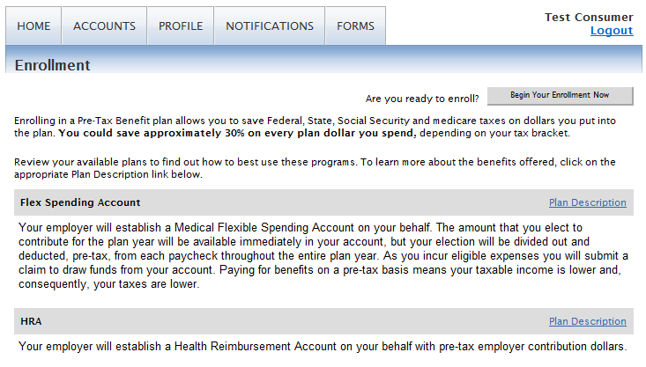
Online Enrollment
Read the ‘Plan Descriptions’ and click Begin Your Enrollment Now.

Slide 6
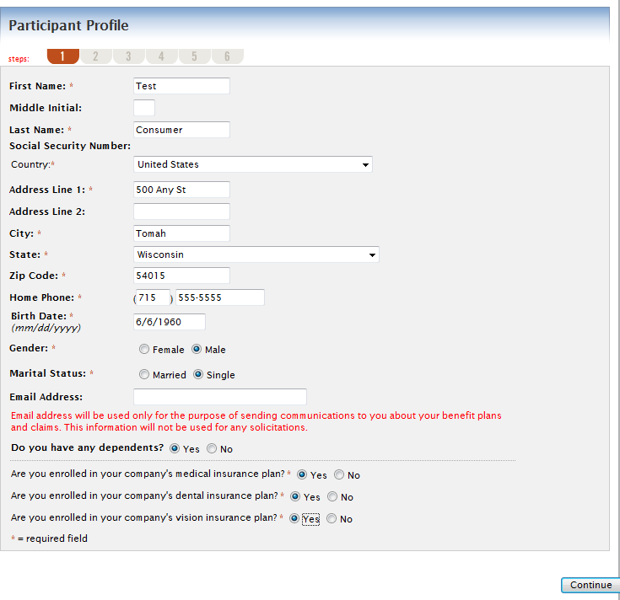
Online Enrollment Profile
Enter all required information.
If you enter ‘Yes’ for ‘Do you have any dependents?’, you will have the option to enter dependent information.
When finished, click Continue.

Slide 7
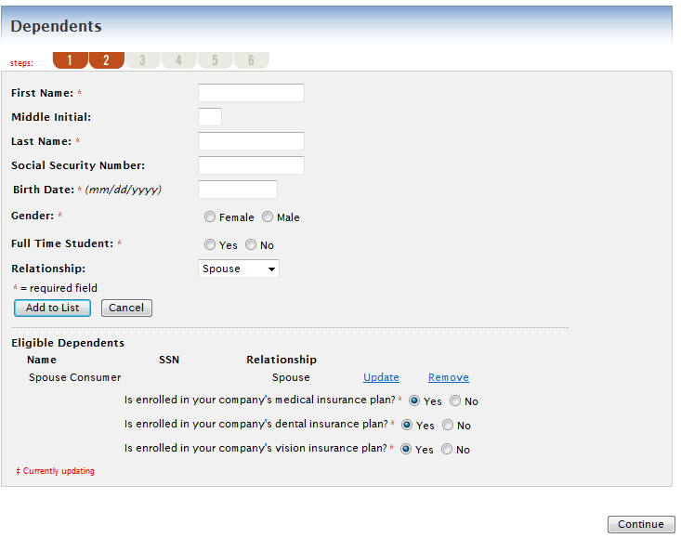
Online Enrollment Dependents
Enter the information and click Add to List (if applicable).
When finished, click Continue.

Slide 8
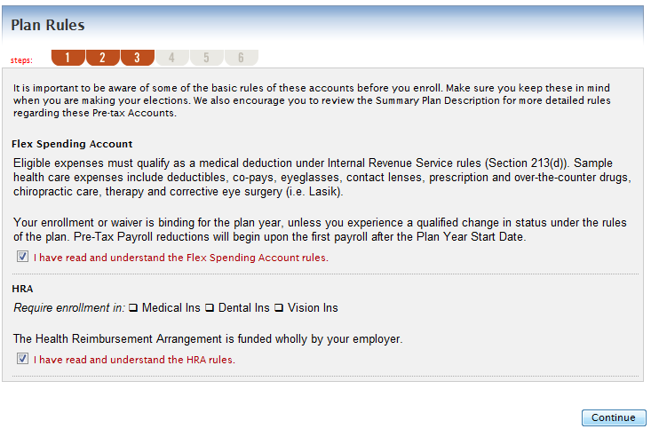
Online Enrollment Plan Rules
Make sure you read and understand the Plan Rules. Check the box(es) and click Continue.

Slide 9
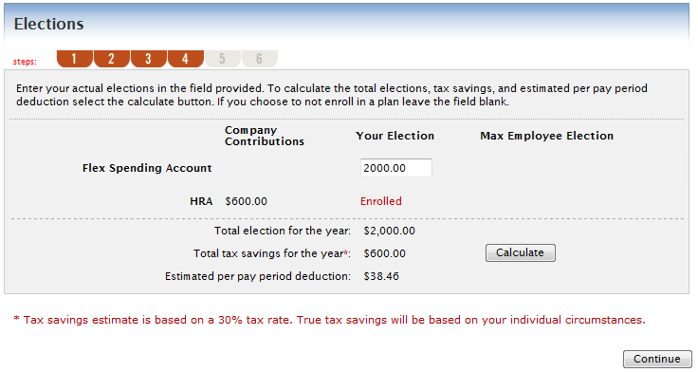
Online Enrollment Elections
Reminder: You can change your election at any time during the open enrollment period.

Slide 10
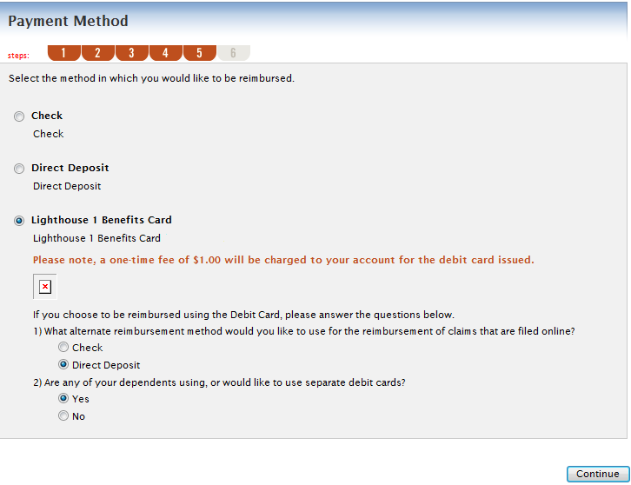
Online Enrollment Payment Method
Depending on your plan, you may have multiple reimbursement options.
If you select debit card, you must also select an alternative reimbursement method.

Slide 11
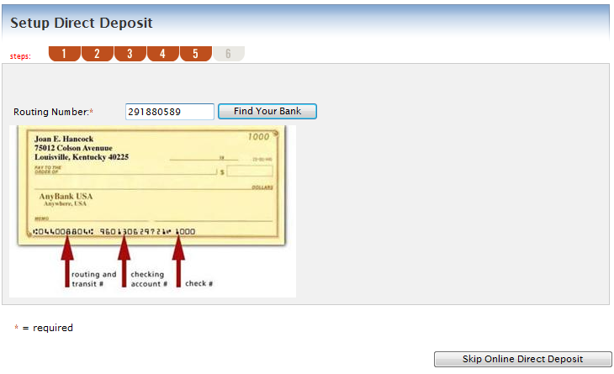
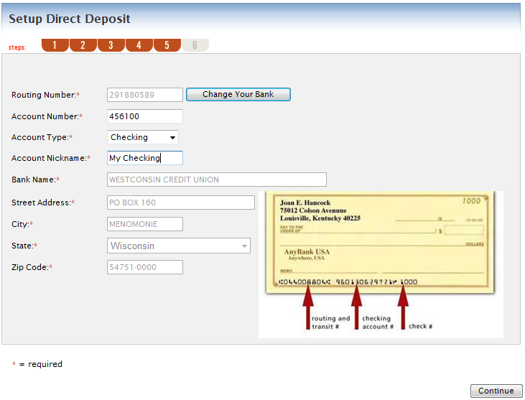
Online Enrollment Payment Method
If you choose direct deposit as a reimbursement method and your employer allows direct deposit setup online, enter your Routing Number and click Find Your Bank.
Your bank information will populate, and you can fill in your bank account information.

Slide 12
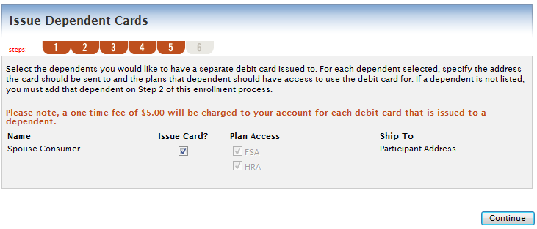
Online Enrollment Payment Method
Select the Dependent(s) to receive Debit Cards (if applicable).
Note: You receive two debit cards with your account. If you need additional cards, you will be charged a $5.00 fee, which is automatically deducted from your account balance.

Slide 13
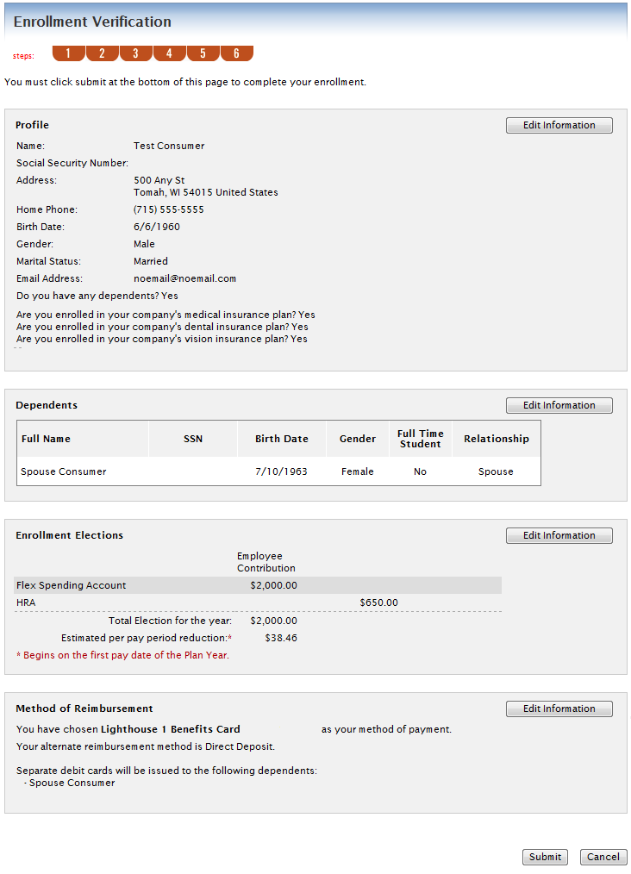
Online Enrollment
Review your information carefully. When complete and accurate, click Submit.

Slide 14
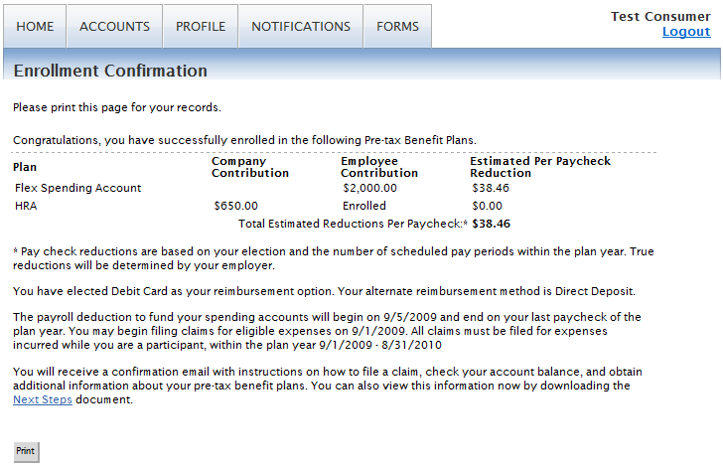
Online Enrollment
The Enrollment Confirmation page will display with the option to ‘Print’ so that you can save a copy for your records. You can also click the Accounts tab and review your eligible amount for each benefit to confirm that your enrollment was successfully completed.
Important: You must complete the entire process until you see the Confirmation page or your information will be lost.
You can log in to the site at any point during the enrollment period to make changes to your information.

Slide 15
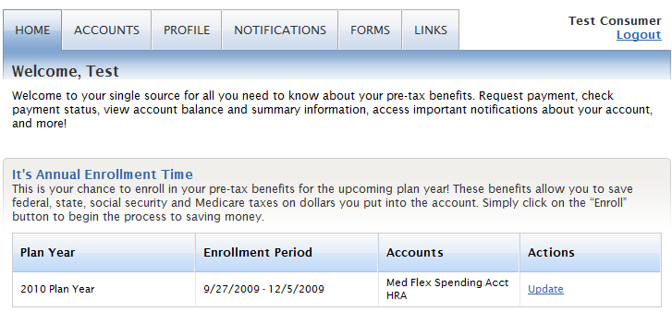
Online Enrollment
Click Update to make changes to existing enrollment. This option is only available during the Open Enrollment Period.

Slide 16
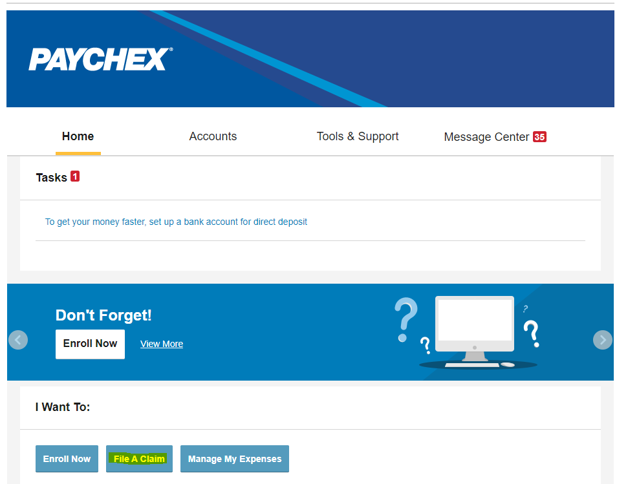
Online Claim Filing
Once you are enrolled and the plan year begins, you can file claims online.
From the Home Screen, click File A Claim.

Slide 17
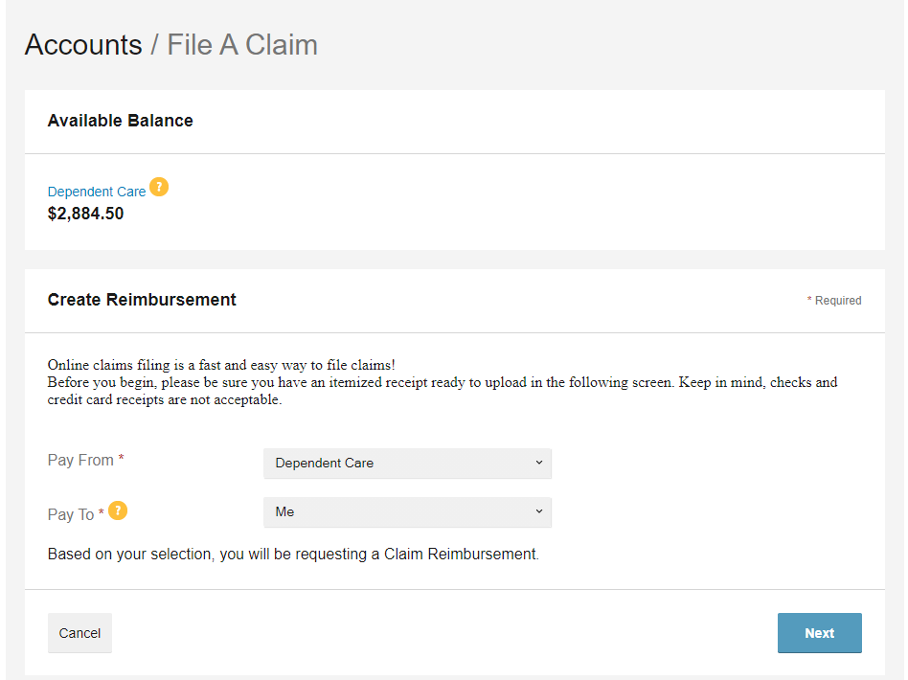
Online Claim Filing
Enter claim information and click Next.

Slide 18
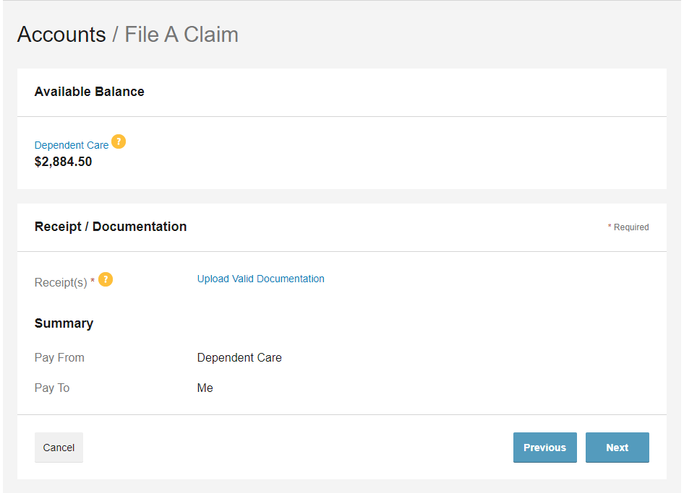
Online Claim Filing
Upload valid claim documentation

Slide 19
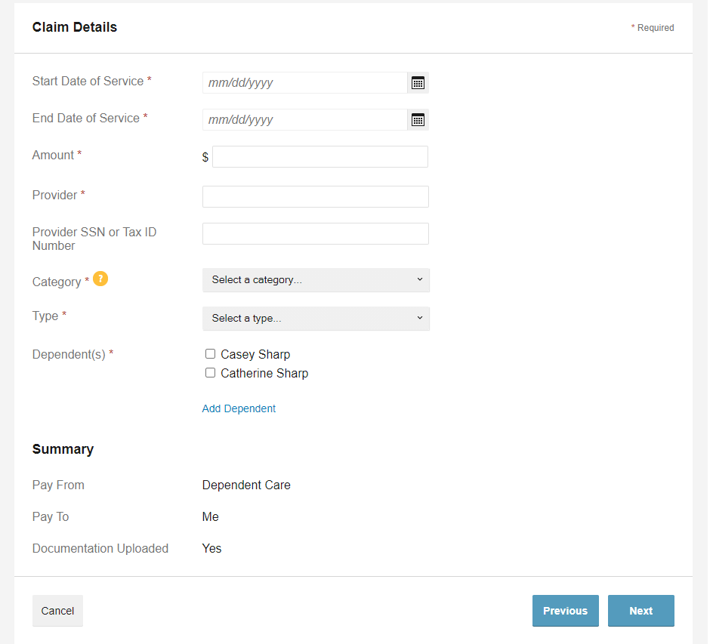
Online Claim Filing
Enter claim details and click Next

Slide 20
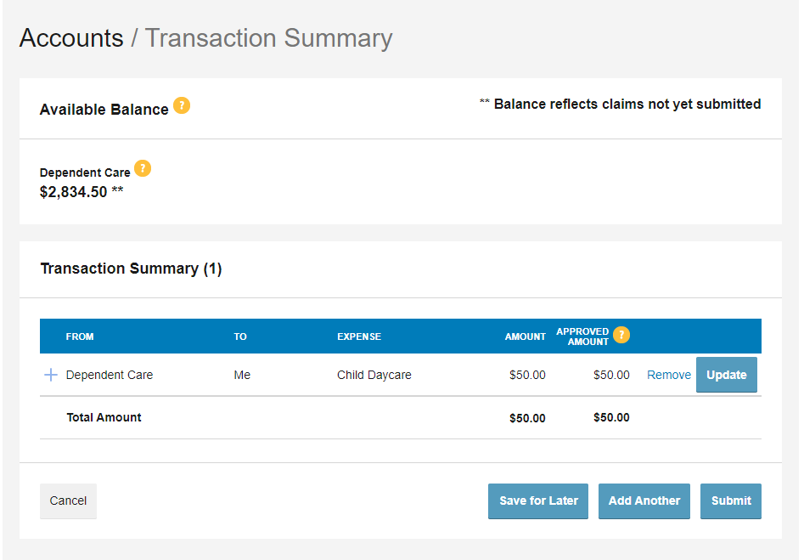
Online Claim Filing
Review your claim details and click Submit

Slide 21
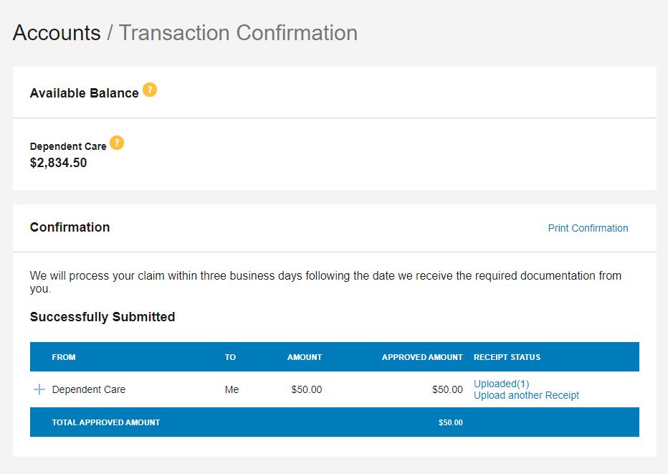
Online Claim Filing
Review your claim confirmation and print if needed.

Slide 22
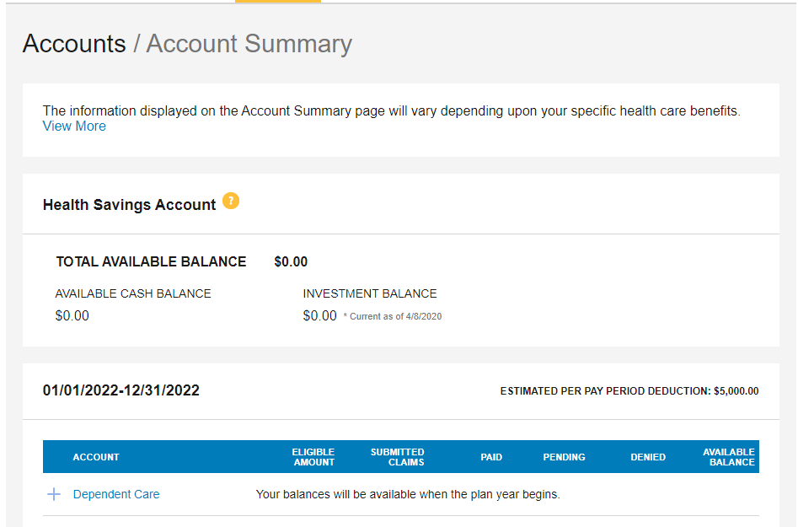
Online Account Administration
You can view account balances, claims, and payment detail, as well as access plan information, forms, and communications.
From the Accounts tab, click Account Summary to view Account Balances.

Slide 23
Online Account Administration
Click the various links to access additional account information.
The plan links under Account display the Plan Rules.

Slide 24
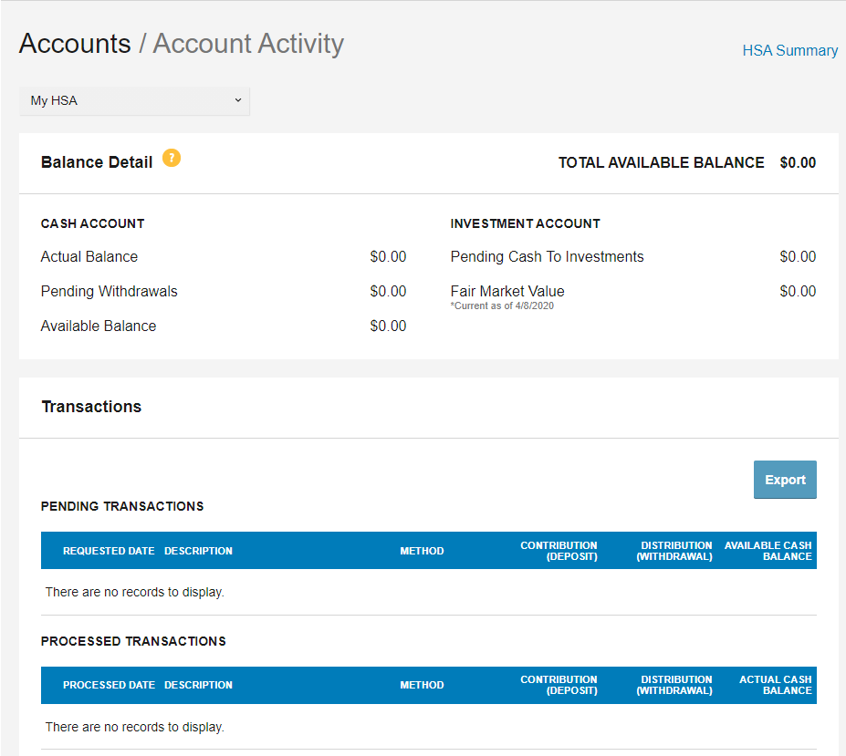
Online Account Administration
Click on Account Activity for a summary of your account balance, pending transactions, and paid claims.

Slide 25
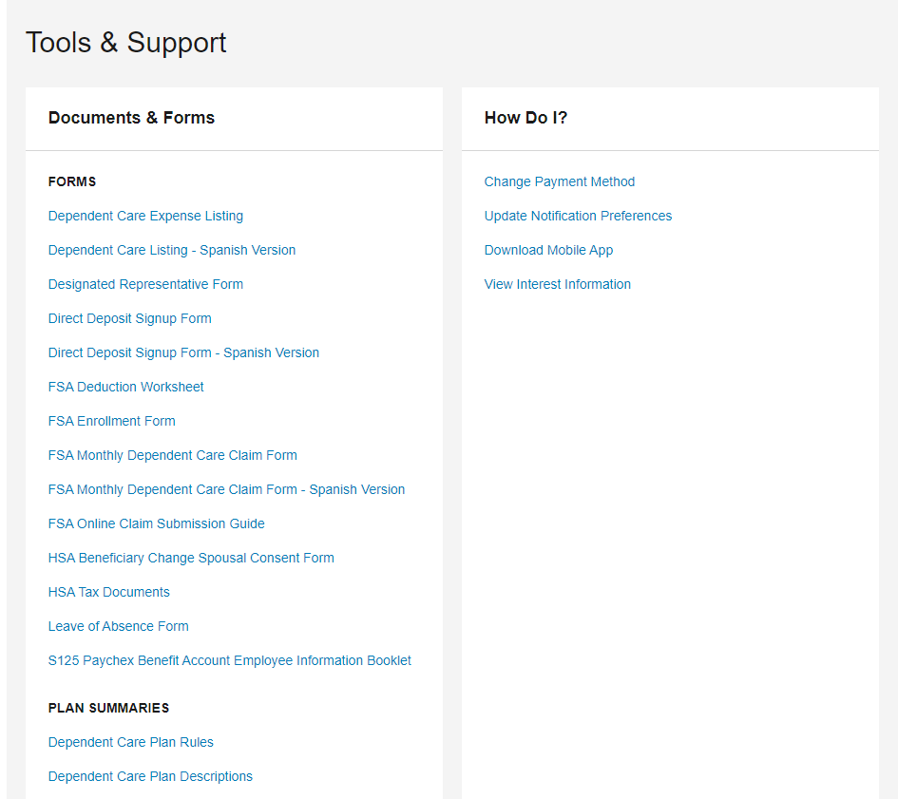
Online Account Administration
Click on Tools and Support for additional resources like Forms, Plan Summaries, and quick links to update your information.

Slide 26
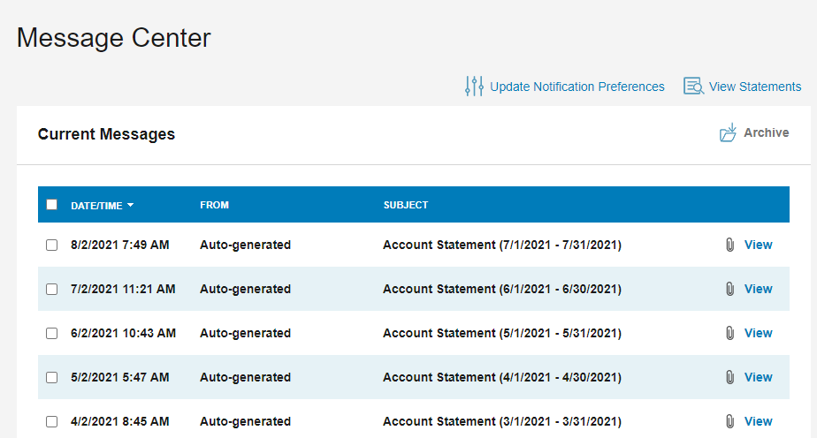
Online Account Administration
The Message Center displays recent notifications, allows you to view statements, and update notification preferences.

Slide 27
Questions
Thank you for taking the time to view this presentation. We encourage you to log in to https://paychex.lh1ondemand.com to become familiar with the options available.
If you have any questions, please contact the Paychex Benefit Account Service Center:
PaychexBenefitAccountCS@healthaccountservices.com
855-678-7781
Monday – Friday, 8:00 a.m. – 8:00 p.m. ET

